Slide 1
Smartcheck Functional Test Kit

Slide 2
Introduction to SmartCheck Functional Test
Purpose of weight
Measure the ability to generate similar results
Ensure repeatable across multiple measures
Eliminate all known systematic sources of error
Recommended frequency
At least once per month, per Mettler Toledo/LabTech Weights and Measures recommendations
May vary depending on lab guidelines, SOPs, and risk assessment such transport of unit

Slide 3
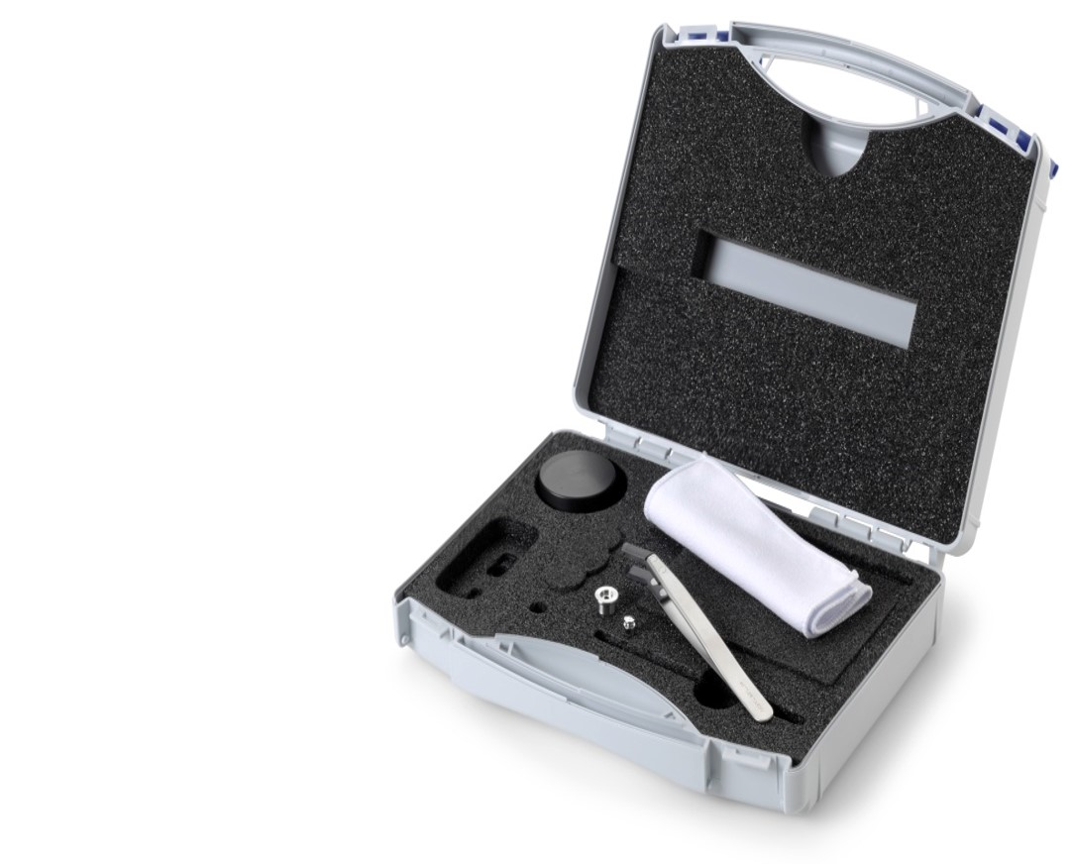
SmartCheck Functional Test Kit
SmartCheck Functional Test Kit includes all components needed to perform a SmartCheck functional test
Storage Case
Cover
Weighing pan
Cleaning cloth
Forceps (tweezers)
1g weight

Slide 4
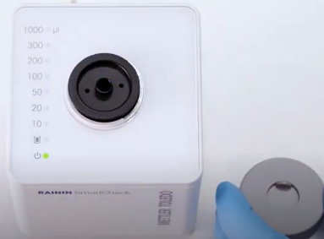
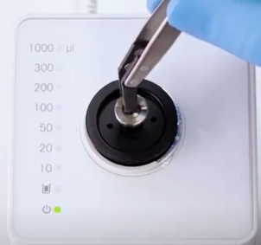
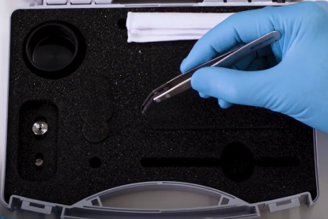
Perform a SmartCheck Functional Test
Follow the steps shown to verify your SmartCheck functions properly
1
Power on SmartCheck then remove draft shield
2
Using tweezers, place weighing pan from your functional test kit atop vessel then cover
3
When 1000uL light blinks, remove cover, place the 1g weight on the pan then cover
4
Wait for 1000uL light to stop blinking

Slide 5
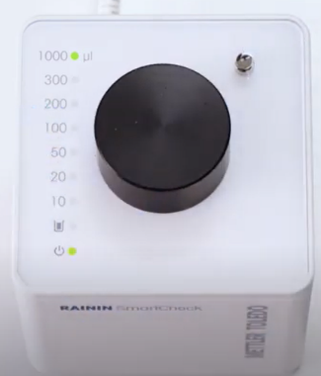
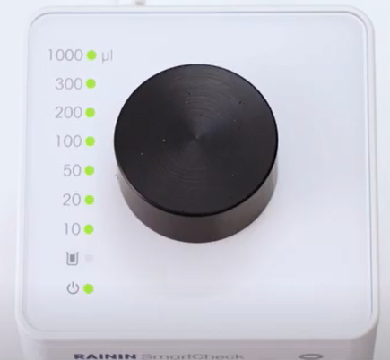
Perform a SmartCheck Functional Test (continued)
Follow the steps shown to verify your SmartCheck functions properly
5
Using tweezers, remove 1g weight then replace cover
Place black cover over 1g weight
6
When 1000uL light blinks, remove cover, place the 1g weight on the pan then cover
7
Wait for 1000uL light to stop blinking then repeat – 10 measurements in total
8
Green lights indicate PASS, SmartCheck is ready for use
Watch YouTube video: "How to check your SmartCheck"

